Slide 1
Robotic Arm
Presented By:
Atharva Shirke &
Shubham Yenkure

Slide 2
Introduction
A robotic arm is a type of mechanical arm, usually programmable, with similar functions to a human arm; the arm may be the sum total of the mechanism or may be part of a more complex robot. The links of such a manipulator are connected by joints allowing either rotational motion (such as in an articulated robot) or translational (linear) displacement.

Slide 3
Components
MG996R Servo Motor
SG90 MICRO Servo Motor
HC-05 Bluetooth module
Arduino board
5V 2A DC power supply

Slide 4
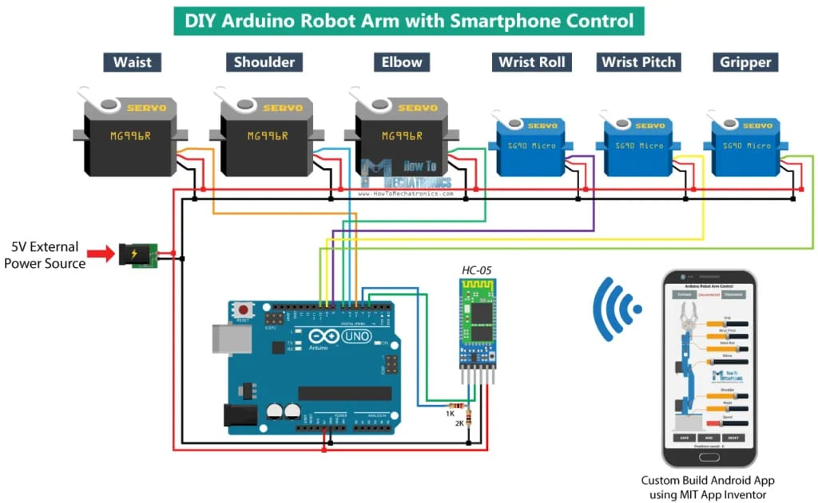
Circuit Diagram

Slide 5
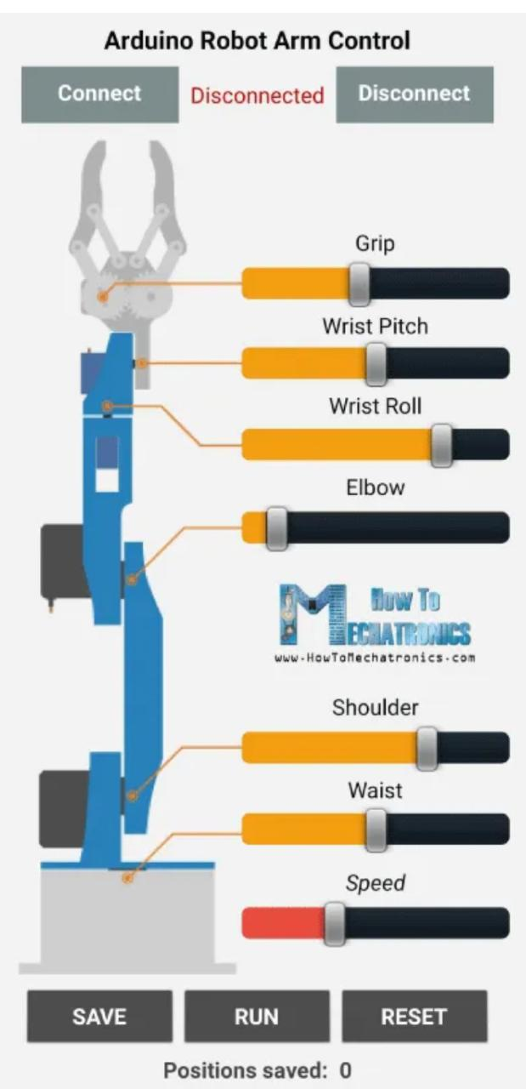
Application UI

Slide 6
Overview
Using the sliders in the app we can manually control the movement of each servo or axis of the robot arm. Also using the “Save” button we can record each position or step and then the robot arm can automatically run and repeat these steps. With the same button we can pause the automatic operation as well as reset or delete all steps so that we can record new ones.

Slide 7
Advantages
Cost Effectiveness
There will be no lunchbreaks, holidays, sick leave or shift time allocated for robotic automation. It can be set to work on a repetitive cycle.
Robotic automation eliminates these risks by accurately producing and checking items meet the required standard without fail.
Using robotic automation to tackle repetitive tasks makes complete sense. Robots are designed to make repetitive movements

Slide 8
Disadvantages
Potential Job Losses
One of the biggest concerns surrounding the introduction of robotic automation is the impact of jobs for workers.
Initial Investment Costs is typically the biggest obstacle that will decide whether or not a company will invest in robotic automation

